Slide 1
Project Report on Used Car Price Prediction
Author : MR. HARSH NEMA

Slide 2

Used Car Price prediction
The used car market is highly competitive and it can be challenging for sellers to determine the right price for their vehicle.
Existing System includes a process where a seller decides a price randomly and buyer has no idea about the car and its value in the present-day scenario.
To build a model that accurately predicts the future value of a used car given its attributes
To help Buyers and Sellers make informed decisions when buying or selling a used car

Slide 3
Problem Statement
The price of a new car in the industry is fixed by the manufacturer with some additional taxes.
With the covid 19 impact in the market, we have seen lot of changes in the car market.
In fact, seller also has no idea about the car’s existing value or the price he should be selling the car at.
Therefore, there is an Urgent Need For A Used Car Price Prediction System which effectively determines the worthiness of the car Using A Variety of Features.

Slide 4
Objective
To scrap used car data of at least 5000 cars from cardekho.com
To Analyze data to gain key insights about current used car market
To build Machine Learning model to predict price of used car.

Slide 5
DATASET Information
Dataset is Scrap from www.cardheko.com
Selenium web driver is used to Scrap data of around 8709 cars
Raw data in excel file contain 8709 rows and 24 feature .
Dataset contain some errors, so data cleaning operation was performed.
Data integrity check is perform for missing values, duplicate data, data error.

Slide 6
Methodology of project
Phase 1 Web Scraping of Used Car Data from www.cardheko.com
Phase 2 Data cleaning, Data preprocessing on Raw data to create error-free, clean dataset.
Phase 3 EDA to gain key insight about used car market
Phase 4 Building Regression based Machine Learning price predication model

Slide 7
Web Scraping Strategy
Phase 1 Web Scraping Strategy employed in this project as follow:
Selenium will be used for web scraping data from cardheko.com
In first part Scraping URL of Used car for different location in India.
Storing Scrap URL in excel file.
Selecting car feature to be scrap from website.
In second part Scraping data from individual URL in excel file.
Exporting final data in Excel file.

Slide 8
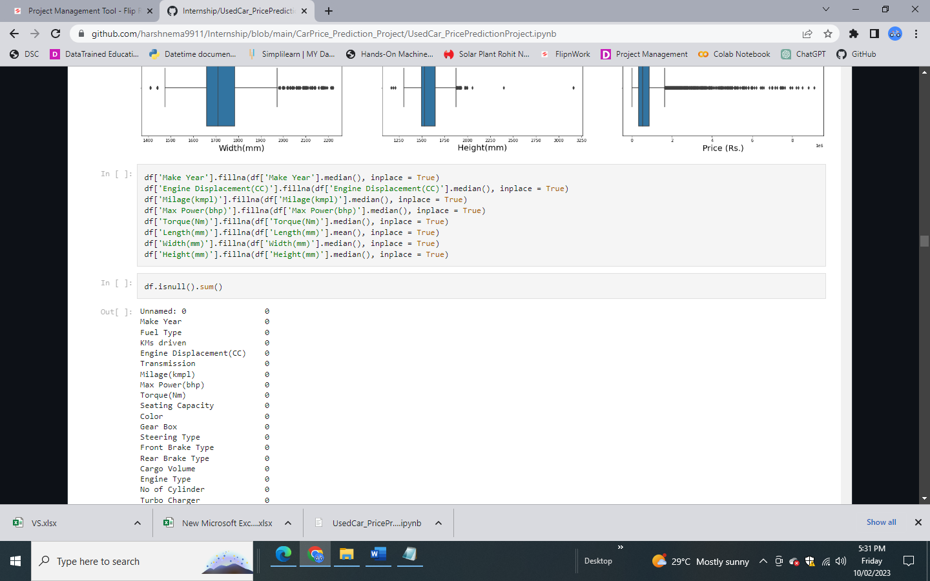
Missing Value imputation
After performing data cleaning operation, data for some of feature is missing.
Strategy for Handling missing data :
Numerical value can be imputed with mean or median depending on sensitive to outliers.

Slide 9
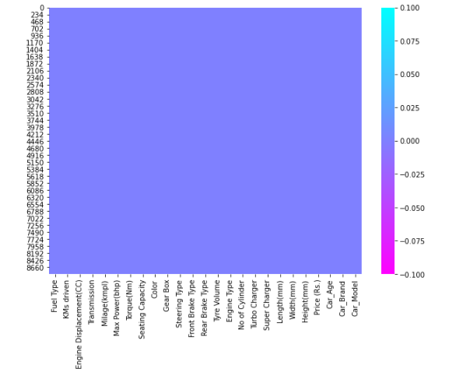
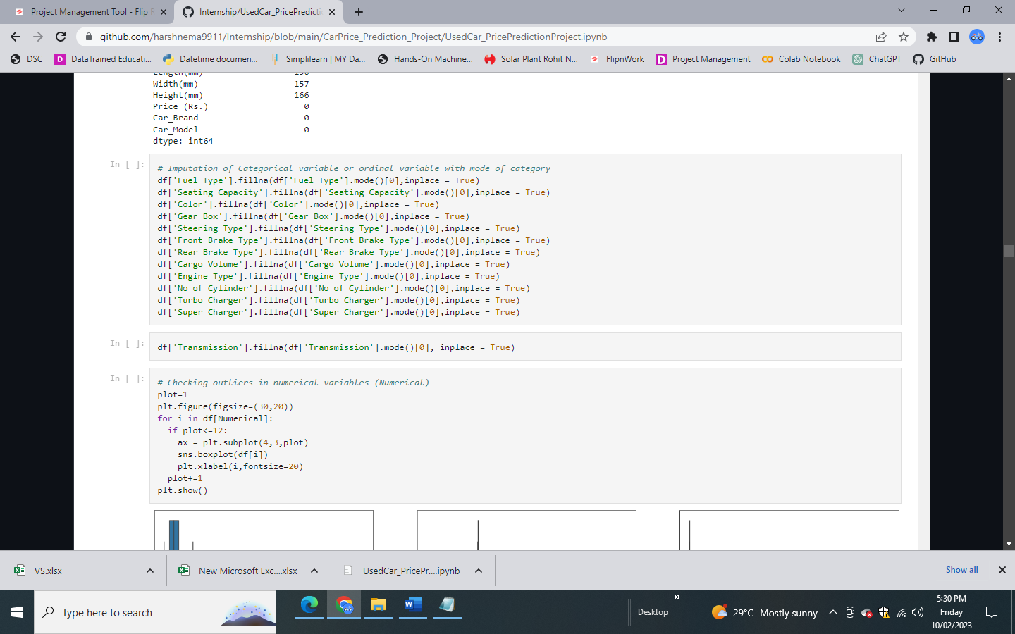
Missing Value imputation
Heat map of Missing Value After Imputation
Imputation of Missing Value for Categorical Variable

Slide 10
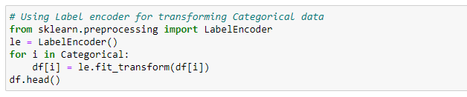
Label Encoding of categorical data
Categorical features are transform using label encoding.

Slide 11
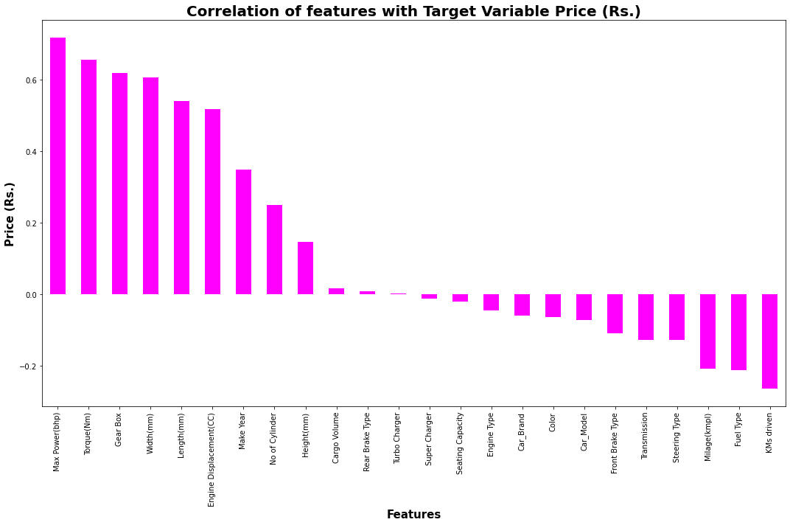
Data Inputs- Logic- Output Relationships
We can see most of feature are either poorly or moderately correlated with target variable Price.

Slide 12
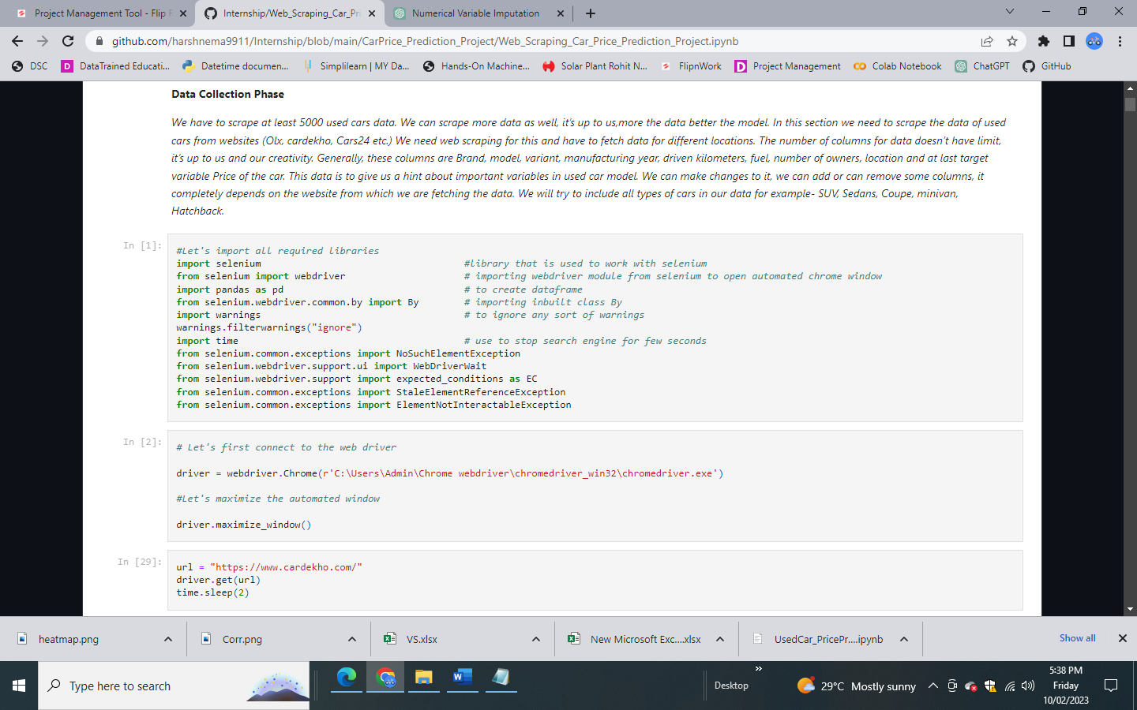
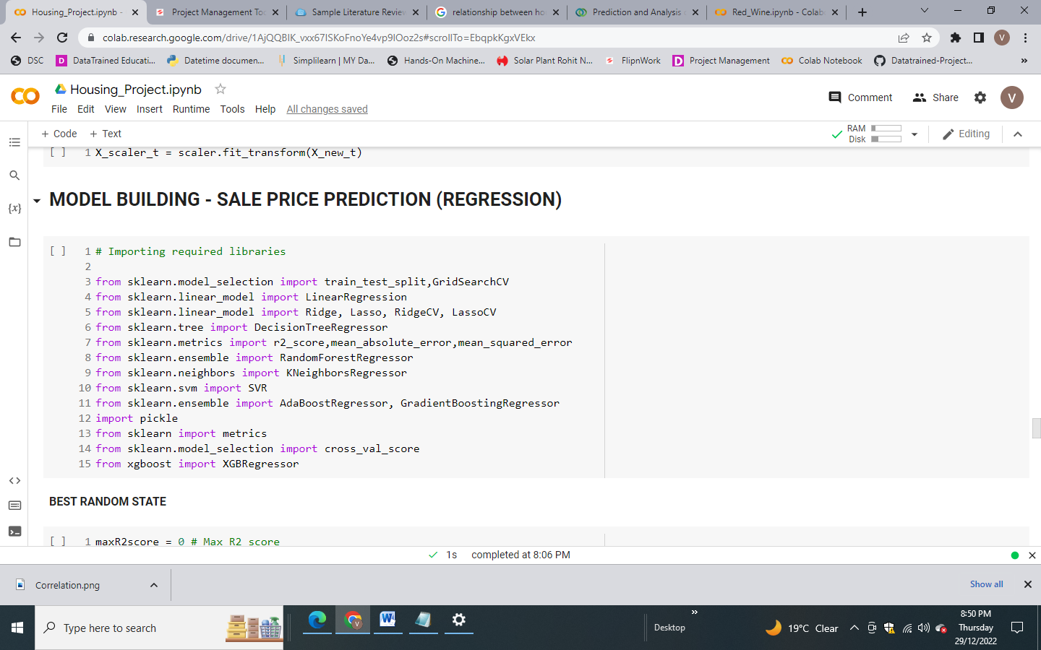
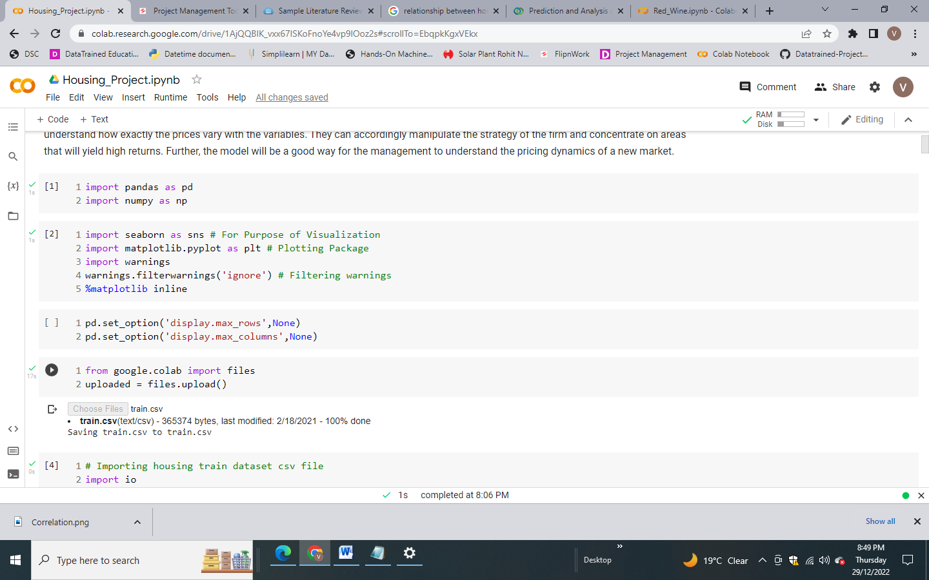
PYTHON Libraries USED IN THIS PROJECT
Different libraries used for web scraping
Machine Learning model building libraries
Visualisation libraries used

Slide 13
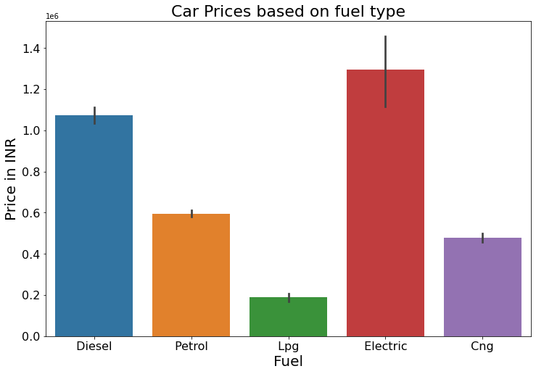
Exploratory Data Analysis Price vs FUEL TYPE distribution
Very small segment of electric car and also price is quite high compare to petrol based
Diesel engines tend to retain their value better than petrol engines, which can contribute to higher prices for used diesel vehicles

Slide 14
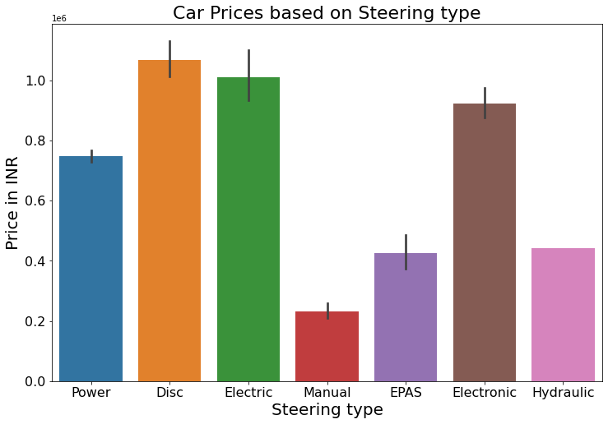
Exploratory Data Analysis price VS STEERING TYPE DISTRIBUTION
The type of steering in a used car can have some impact on its value, but it is not typically a significant factor.
Very small section of car still uses Manual Steering, Most probably they belong to old model.

Slide 15
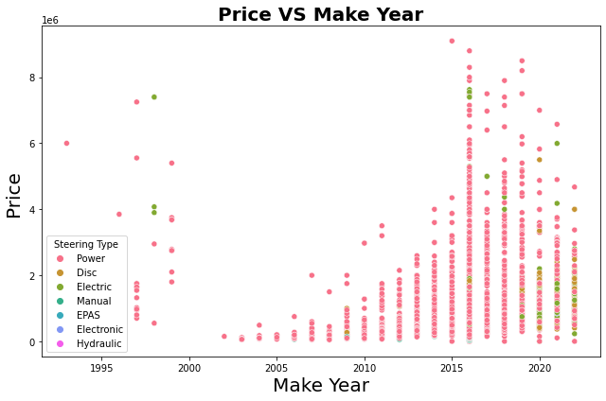
Exploratory Data Analysis Price Vs Make Year
Generally, older cars are cheaper, but their condition also affects their value
A used car in excellent condition will be worth more than one in poor condition, even if it is newer
As it can be seen that some power steering 2015 cars are costlier than 2020 manufactured cars

Slide 16
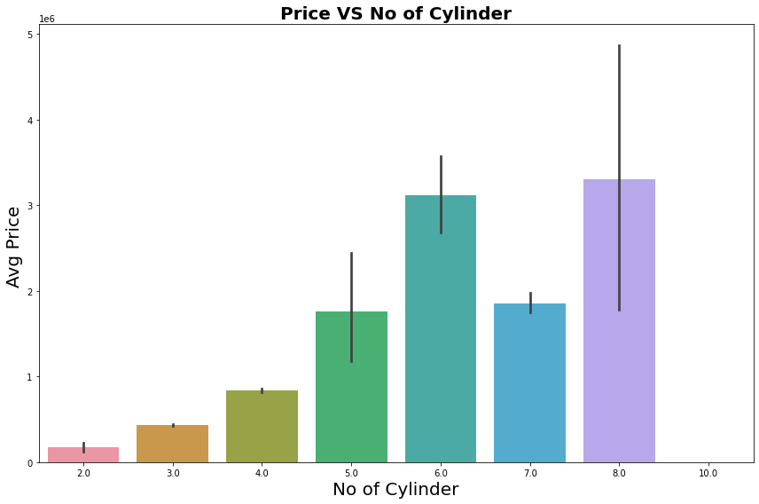
Exploratory Data Analysis NO OF CYLINDER vs price
Cars with more cylinders tend to be more powerful and perform better.
Therefore, they command a higher price in the used car market

Slide 17
Exploratory Data Analysis CAR AGE vs price
As car get older, price of car deprecates.

Slide 18
MACHINE LEARNING MODEL BUILDING
Objective is to predict price of used car . It can be solve by application of regression ML algorithm.
Different Regression algorithm used to train model, in order build ML model with maximum R2 Score.
Machine learning classification algorithms used in this project are –
Random Forest Regressor
KNeighbors Regressor
XGB Regressor
Extra Trees Regressor
Ada Boost Regressor

Slide 19
KEY METRICS FOR SUCCESS IN SOLVING PROBLEM UNDER CONSIDERATION
Mean absolute error which gives magnitude of difference between the prediction of an observation and the true value of that observation.
Root mean square error is one of the most commonly used measures for evaluating the quality of predictions.
R2 score which tells us how accurate our model predict result, is going to important evaluation criteria along with Cross validation score.

Slide 20
ML MODEL Evaluation Matrix
On Basis of difference between R2 Score and Cross Validation Score Extreme Gradient Boost Regressor (XGB) is selected as best model with 89.16% R2_score.
Final Model is giving us R2 Score of 92.90% which is slightly improved compare to earlier R2 score of 89.16%.
ML Algorithm | R2 Score |  | CV Score
 | Train | Test
Linear Regression | 65.54% | 66.84% | -1.06
K Neighbors Regressor | 87.36% | 83.48% | 72.19%
Random Forest Regressor | 98.54% | 92.72% | 85.75%
Ada Boost Regressor | 55.48% | 47.19% | 60.37%
Extra Trees Regressor | 99.98% | 92.83% | 81.66%
Extreme Gradient Boost Regressor(XGB) | 90.03% | 89.16% | 81.59%
Hyper Parameter Tuning for XGB | 96.72% | 92.90% | 85.28%

Slide 21
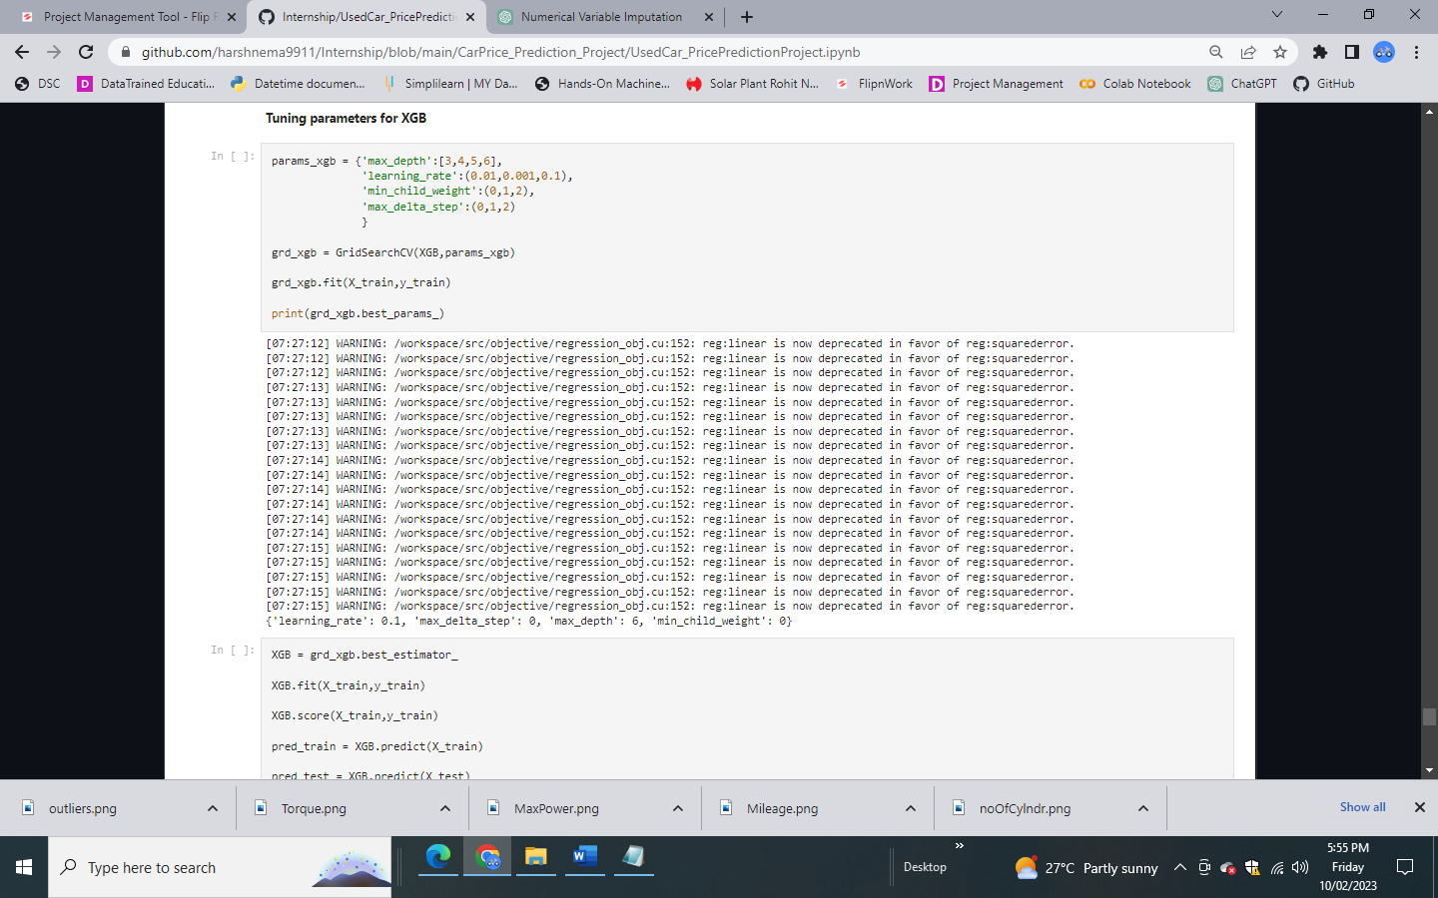

Final Hyper parameter tuned ml model
On Basis of difference between R2 Score and Cross Validation Score Extreme Gradient Boosting Regressor is selected as best model
Hyper Parameter tuning is performed over this model

Slide 22
Limitations & Scope for Future OF THIS Work
Around 8000 used car data scraped from cardheko.com
We can scrap more data from different online platform like olx, car24. More data obviously means more accurate predication.
Here we scrap almost 24 features. But there are many different kinds of safety, comfort, entertainment features to which buyer weight while buying car. We can also include such more feature in future.

Slide 23


